Slide 1
Unit 2. Structure and function of the nervous system: Molecular, cellullar, synaptic, and circuit levels.
2.1. The cells of the nervous system
2.2. Resting and action potential
2.2.1. Membrane transport
2.2.2. Ions and ion transport across the cell membrane
2.2.3. The equilibrium potential
2.2.4. The resting potential
2.2.5. The action potential
2.3. Synaptic transmission
2.4. Synaptic plasticity

Slide 2
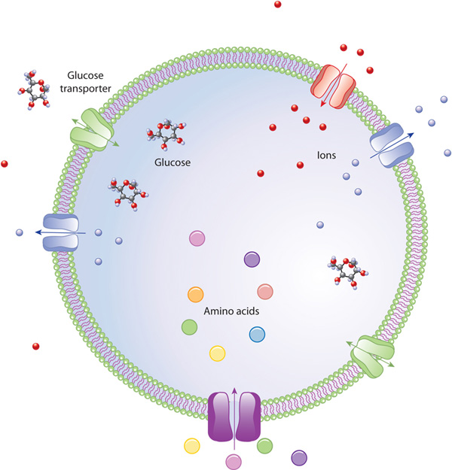


2.2.1. Membrane transport
MEMBRANE TRANSPORT
CELL MEMBRANES ARE SEMIPERMEABLE
Gases, lipids, lipid-soluble
Small uncharged polar
Large uncharged polar, charged atoms (ions)
Cell membrane (cytoplasmic membrane)

Slide 3
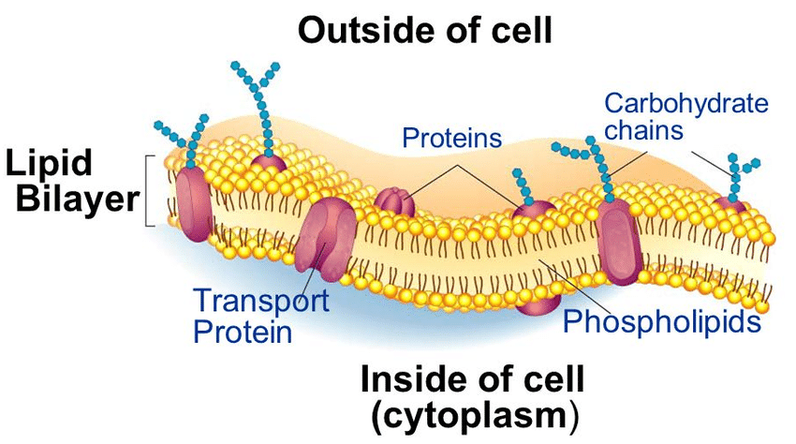
2.2.1. Membrane transport
MEMBRANE TRANSPORT
Cell membranes are mainly composed of a phospholipid bilayer.
Other components are embedded in the membrane: proteins, cholesterol etc.
Some membrane proteins function as transporters of different substances (ions, neurotransmitters, glucose, etc.)
Conference paper: 10.1109/INTERCON.2018.8526460

Slide 4
2.2.1. Membrane transport
FORMS OF TRANSPORT
Molecules are constantly moving
Net movement follows the LAW OF DIFUSION
All molecules tend to distribute evenly in the available space and the net movement depends on the chemical gradient of a substance
CHEMICAL GRADIENT: Difference in concentration between place A and place B.
A
B
CHEMICAL GRADIENT = CHEMICAL DRIVING FORCE
The higher the concentration gradient the higher the magnitude of chemical driving force

Slide 5
2.2.1. Membrane transport
FORMS OF TRANSPORT
Chemical driving force
Net movement

Slide 6
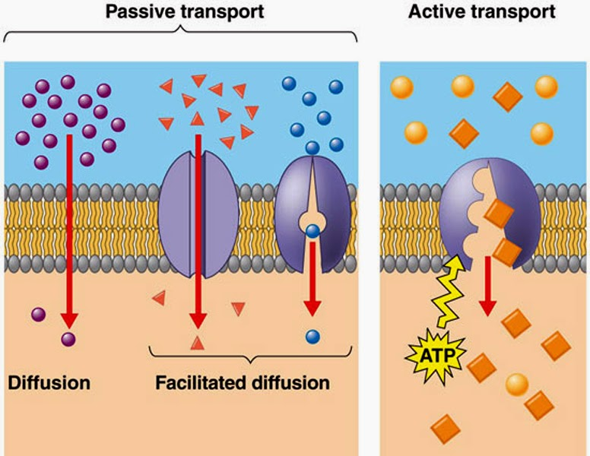
2.2.1. Membrane transport
FORMS OF MEMBRANE TRANSPORT
But what happens when there is a barrier that does not allow the free movement of substances between point A and point B?

Slide 7
2.2.1. Membrane transport
FORMS OF MEMBRANE TRANSPORT
But what happens when there is a barrier that does not allow the free movement of substances between point A and point B?
PASSIVE TRANSPORT
The movement occurs in the direction of the concentration gradient
Simple diffusion → no need for carrier proteins and/or channel proteins
Facilitated diffusion→ channel proteins and/or carrier proteins are required
NO ENERGY EXPENDITURE

Slide 8
2.2.1. Membrane transport
FORMS OF MEMBRANE TRANSPORT
But what happens when there is a barrier that does not allow the free movement of substances between point A and point B?
ACTIVE TRANSPORT
The movement occurs AGAINST the direction of the concentration gradient
It requires a special kind of carrier protein called “pump”.
It can facilitate crossing of any type of substance (lipophilic, hydrophilic, ions, etc.)
IT REQUIRES ENERGY EXPENDITURE IN THE FORM OF ATP

Slide 9
2.2.1. Membrane transport
FORMS OF MEMBRANE TRANSPORT
But what happens when there is a barrier that does not allow the free movement of substances between point A and point B?
ACTIVE TRANSPORT
The movement occurs AGAINST the direction of the concentration gradient
It requires a special kind of carrier protein called “pump”.
It can facilitate crossing of any type of substance (lipophilic, hydrophilic, ions, etc.)
IT REQUIRES ENERGY EXPENDITURE IN THE FORM OF ATP

Slide 10
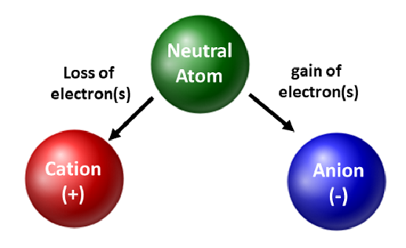
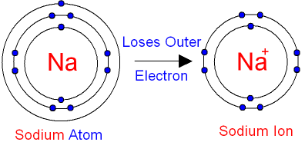
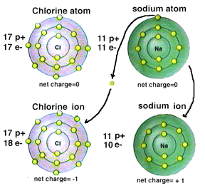
2.2.2. Ions and ion transport across the cell membrane
What is an ion?
https://www.youtube.com/watch?v=utLoRJootfY

Slide 11
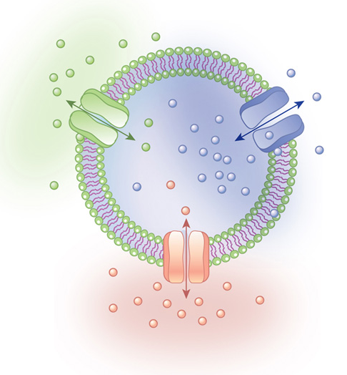
2.2.2. Ions and ion transport across the cell membrane
TRANSPORT OF IONS
Extracellular and intracellular liquids contain IONS
MASS
Concentration gradient
ELECTRICAL CHARGE
Electrical gradient
© 2014 Nature Education

Slide 12
2.2.2. Ions and ion transport across the cell membrane
TRANSPORT OF IONS
Electrical driving force
ELECTRICAL GRADIENT
Differences in electrical charges between point A and point B
Ions of the same charge repel each other
Ions of different charge attract each other

Slide 13
2.2.2. Ions and ion transport across the cell membrane
TRANSPORT OF IONS
LAW OF DIFUSION (“chemical driving force”)
ELECTRICAL OR ELECTROSTATICAL driving force
Mass → Chemical forces
ELECTROCHEMICAL GRADIENT
IONS
E Charge → Electrical forces
Ions tend to move down their “electrochemical gradient”

Slide 14

2.2.2. Ions and ion transport across the cell membrane
TRANSPORT OF IONS
Large uncharged polar, charged atoms (ions)
So, how do ions cross the membrane?
2 kinds of ion channels
PASSIVE (or leak channels)
They are always open
ACTIVE (or gated channels)
They are usually closed, except under certain conditions:
A specific change in membrane voltage (voltage-gated channels)
Binding of a substance to a specific site (Ligand-gated channels)

Slide 15
2.2.3. The equilibrium potential
ELECTROCHEMICAL EQUILIBRIUM
One or more ions CANNOT cross it
SUMMARY
One or more ions CAN cross it
Semipermeable membrane
The ions that can cross it will distribute asymmetrically on both sides of the membrane.
As a result, there will be a voltage across the cell membrane → membrane potential.
The membrane potential (voltage) will act as an electrical driving force acting on the ions that are inside and outside the cell.
For each ion there can be a situation in which this ion is in electrochemical equilibrium: the ion is pushed towards one direction by the chemical driving force and towards the opposite direction by the electrical driving force (voltage), anb both forces have the same intensity

Slide 16
2.2.3. The equilibrium potential
NERNST EQUATION
The Nernst equation calculates which is the value that the membrane potential (or electrical driving force) should attain for a given ion to be in electrochemical equilibrium. This value is called equilibrium potential
Semipermeable membrane
X⁺
X⁺
Difference in electrical potential that balances the difference in concentration between inside and outside. Is represented as Eion
Y⁻
E
?
RT zF
X⁺
E_{X}
2,303
A
A
B
log
X⁺
If: E_{X+} = -75 mV
B
The equilibrium potential of X⁺ is -75mV
X⁺ is in electrochemical equilibrium when the membrane potential is -75mV
X+ will tend to cross the cell membrane in the direction required to reach its equilibrium potential
-75 mV
https://www.youtube.com/watch?v=ZVUWyDzmApg

Slide 17
2.2.3. The equilibrium potential
NERNST EQUATION
For example if: E_{X+} = -75 mV
Semipermeable membrane
C
The equilibrium potential of X⁺ is -75mV
X⁺ is in electrochemical equilibrium when the membrane potential is -75mV
X+ will tend to cross the cell membrane in the direction required to reach its equilibrium potential
The latter will only be possible if the membrane is permeable to X+ (i.e., if the membrane contains open channels for X+)
X⁺
X⁺
Y⁻
E
?
A
B
-75 mV
https://www.youtube.com/watch?v=ZVUWyDzmApg

Slide 18
MEMBRANE POTENTIAL AND RESTING POTENTIAL
The fact that there are differences in the distribution of ions (and electrical charges) between the inner and outer sides of the neurons generates electrostatic driving forces
REMEMBER
Living cell membranes are semipermeable
These electrostatic driving forces are called MEMBRANE POTENTIAL
They are measured in mV

Slide 19
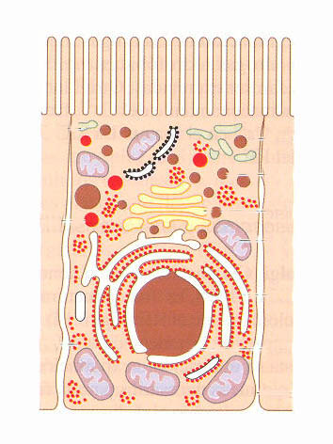
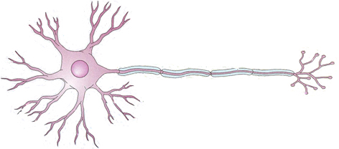
MEMBRANE POTENTIAL AND RESTING POTENTIAL
V = 0
MEMBRANE POTENTIAL
In any living cells
present in all the living cells
Has negative values (higher number of negative ions inside the cell)
It is relatively constant
In Neurons
V = -70 mV
It can vary under specific stimuli
When the neuron is not receiving or sending stimuli (“resting” neuron)
RESTING POTENTIAL

Slide 20
MEMBRANE POTENTIAL AND RESTING POTENTIAL
MEMBRANE POTENTIAL
Value of the membrane potential at a given time
RESTING POTENTIAL:
Value of the membrane potential when the neuron is in resting state (not sending or receiving stimuli)

Slide 21
RESTING POTENTIAL
What is the value of resting potential?
If the membrane of the neurons were only permeable to a single ion (let’s say to ion X⁺), resting potential (V_{m}) would be equal to E_{X+} (equilibrium potential for ion X)
When neuron membrane is permeable to more than one ion (for example, to ions X⁺ and Y⁻), the value of the resting potential (V_{m}) will be intermediate between the equilibrium potentials of the permeable ions (E _{X}⁺ E _{Y}⁻)

Slide 22
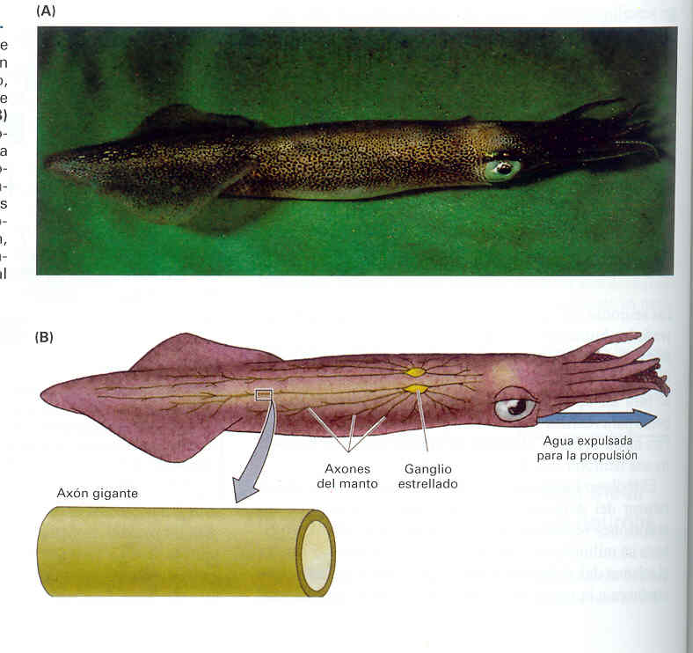
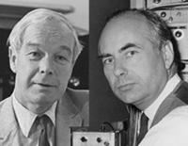

RESTING POTENTIAL: How was it discovered?
Squid giant axons
Squid giant axons : 1mm
vertebrate axons: 1-20 µm
Young, and several years later (forties and fifties of the 20th century), Hodgkin, Huxley, Katz, and other researchers made crucial contributions to understand the membrane potential
https://www.youtube.com/watch?v=CXCGqwdtJ78

Slide 23
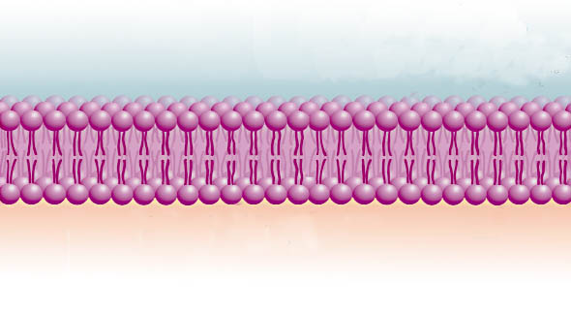
RESTING POTENTIAL: Normal ion concentrations inside and outside neurons
V= -70 mV
Cl⁻
Na⁺
K⁺
Outside
Inside
A⁻
K⁺
Cl⁻
Na⁺
Membrane potential is a consequence of SEMIPERMEABILITY of cell membrane
But why is it negative, and why does it have a value around
- 60/-70 mV?

Slide 24
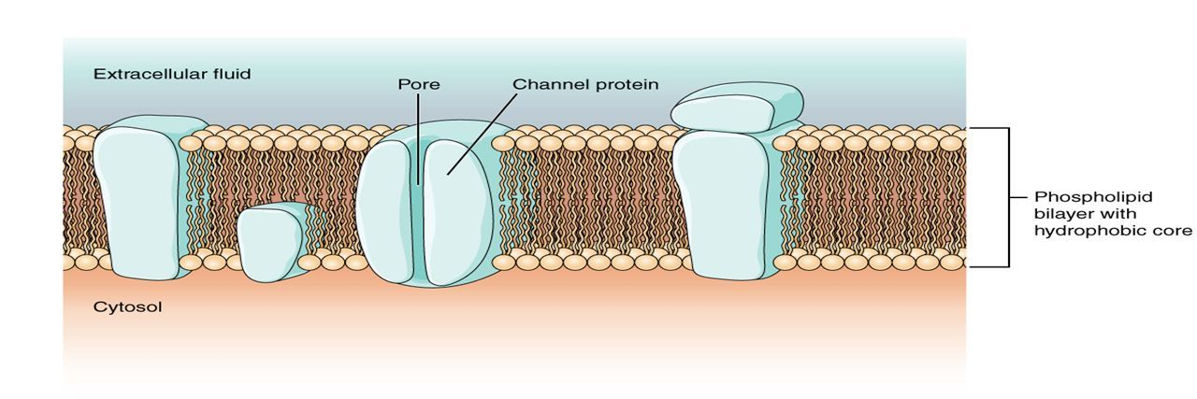
RESTING POTENTIAL: Membrane permeability
REMEMBER: 2 kinds of ion channels
PASSIVE (or leak channels)
They are always open
ACTIVE (or gated channels)
They are usually closed, except under certain conditions
These conditions include:
A specific change in membrane voltage (voltage-gated channels)
Binding of a substance to a specific sity (Ligand-gated channels)

Slide 25
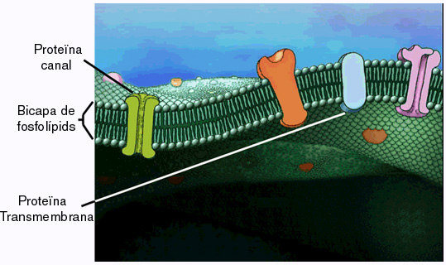
RESTING POTENTIAL: Membrane permeability
Resting conditions (no stimuli):
Only passive channels are open, while active channels are closed
The neuron has a lot of passive or leak K⁺channels
Very few passive or leak channels for Na⁺ and other ions

Slide 26
RESTING POTENTIAL: What are the factors that determine its specific value?
V= -70 mV
Cl⁻
Na⁺
K⁺
Outside
Inside
A⁻
K⁺
Cl⁻
Na⁺
(Organic or proteic anions)
The value of resting potential is highly dependent on K⁺
1.1 Cellular: Electrochemical Gradients - YouTube

Slide 27
POTENCIAL DE REPÒS
RESTING POTENTIAL: What are the factors that determine its specific value?
V= -70 mV
The critical importance of K⁺
E_{K}= -75 mV
K⁺
Outside
Inside
K⁺
But K+ is not the only factor affecting resting Vm
A⁻
The few passive channels for Na+ and Cl- have also an influence

Slide 28
RESTING POTENTIAL: What are the factors that determine its specific value?
V= -70 mV
E_{K}= -75 mV
K⁺
Cl⁻
Na⁺
Outside
Inside
A⁻
K⁺
Cl⁻
Na⁺
E_{Cl}= -65 mV
E_{Na}= +55 mV
How can we calculate the influence of K+ and other ions?

Slide 29
RESTING POTENTIAL: What are the factors that determine its specific value?
Why resting potential is not exactly equal to EK+?
K⁺ leaks outside of the neuron using leak channels
But there are also a few leak channels for Na⁺ . A few Na+ ions go inward.
Outside
Na+
In spite of continuous leakage of K+ and Na+, the concentrations of these ions remain relatively constant
Resting Pot.
V= -70 mV
K⁺
K⁺
^{Why?}
Na+
Inside
V_{K}= -75 mV

Slide 30



RESTING POTENTIAL: The Na⁺-K⁺ pump
3 Na⁺
Na⁺ / K⁺ pump (Na⁺ / K⁺ ATPase)
K⁺
Na⁺
Ext
ATP
Int
ATP
2 K⁺
ADP
Ext.
Int.
Out
Out.
In
In
P
Out
In
P
P
https://www.youtube.com/watch?v=AkiaMiGnPuQ

Slide 31
RESTING POTENTIAL: The Na⁺-K⁺ pump
3 Na⁺
Ext
ATP
Int
2 K⁺
Pumps out 3 Na⁺ and pumps in 2 K⁺
Againts electrochemical gradient → Active transport → ATP
Keeps the concentration gradients of Na⁺ and K⁺ rather stable
Favours inner electrical negativity
It’s an ELECTROGENIC pump

Slide 32
RESTING POTENTIAL: In summary
It is generated as a consequence of the lack of permeability of the cell membrane to large organic anions (A-), and to different permeabilities to other ions
Potassium has a large influence, because the membrane is higly permeable to this ion (a lot of passive or leak K+ channels)
Na⁺/K⁺ pump is very important, because it keeps relatively constant the inner and outer ion concentrations (and, therefore, also keeps constant resting potential values)
V= -70 mV
K⁺
Na⁺/K⁺
A⁻
K⁺
1.1 Cellular: Electrochemical Gradients - YouTube

Slide 33

Now imagine that the membrane of neurons has a high amount of leak channels for Na+ and a low number of leak channels for K+. In this cell the equilibrium potential for Na+(ENa+) is +50mV.
What will be, approximately, the value of the resting potential in these conditions? Why?
Now we go back to the normal situation (more leak channels for K+ than for any other ions). The resting potential is around -70mV.
What will happen with the membrane potential if + ions are going into the cell?
And if it is – ions that go in?

